Slide 1

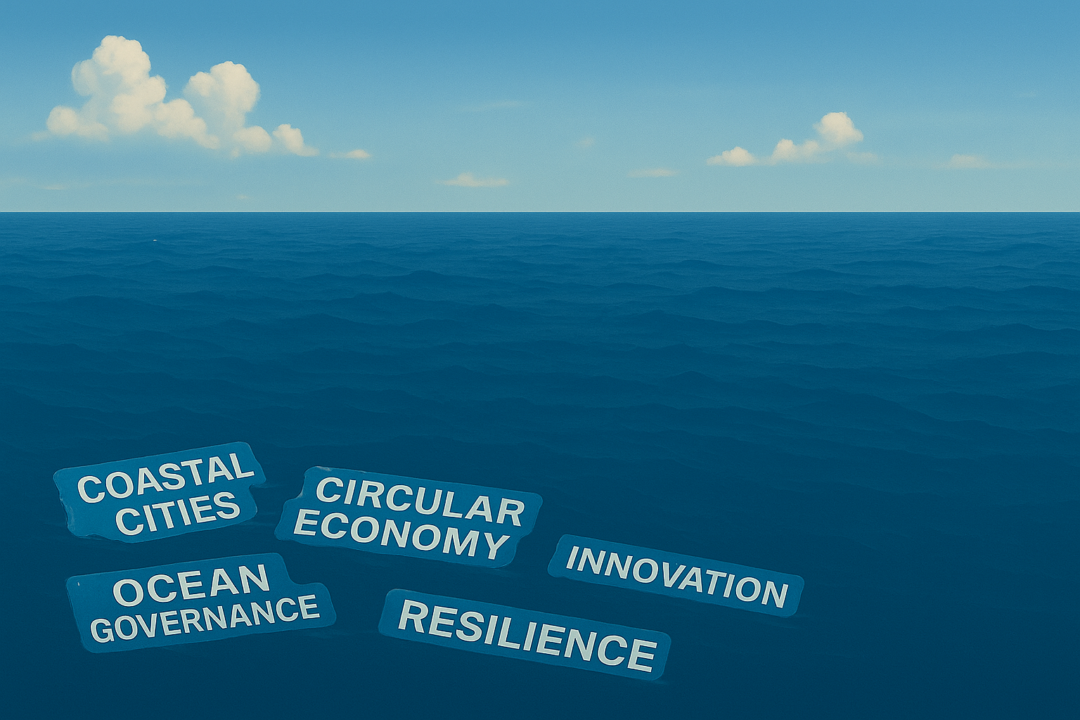



Coastal Cities as Source and Solution:
Shifting the Plastics Pollution Paradigm
Session 1B at the 20th Global Forum of Human Settlement
4 November 2025, World Meteorological Organisation, Time: 2:20 pm - 3:40 pm, Geneva

Slide 2
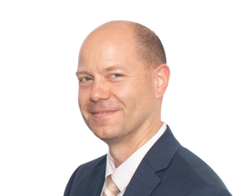
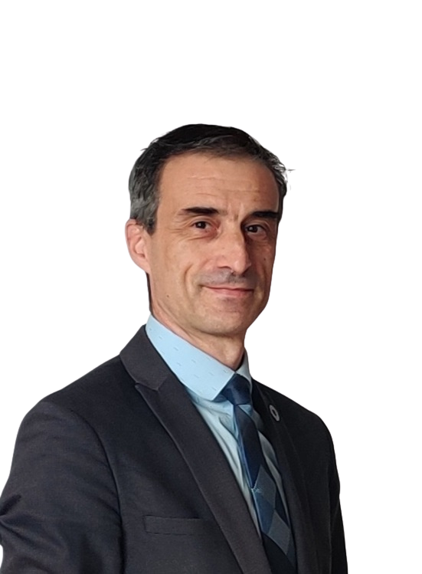
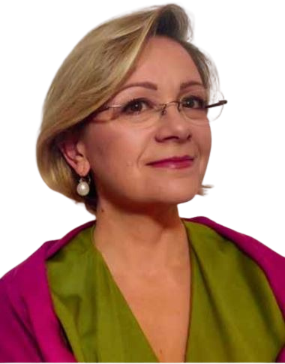
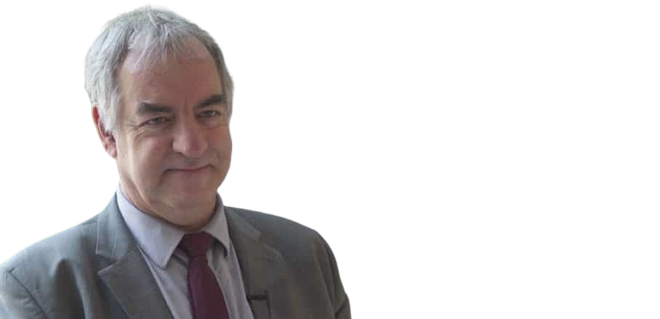
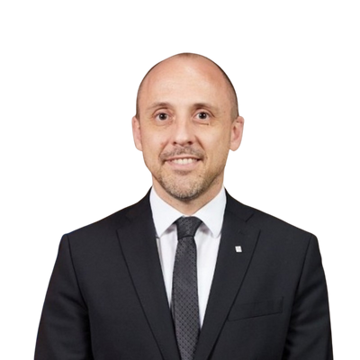
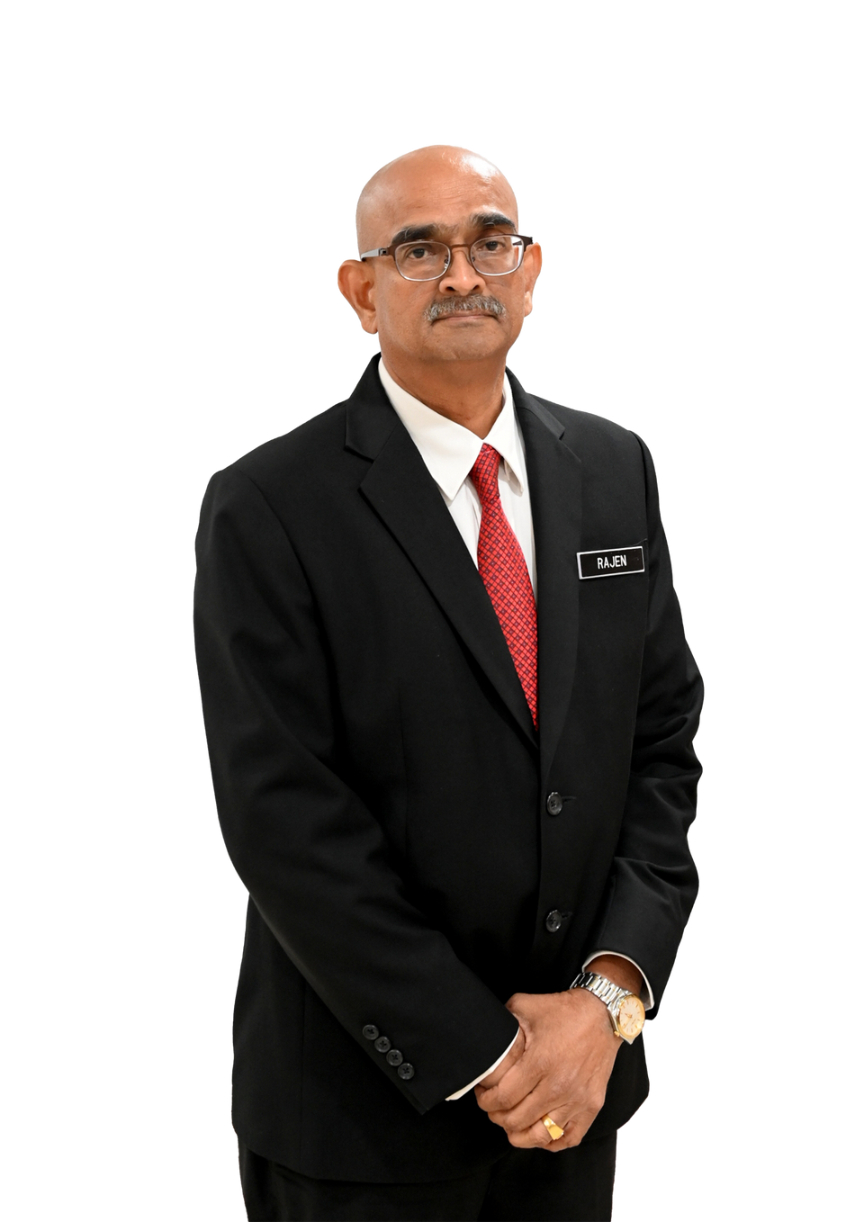
MODERATOR
SPEAKERS
ANDRÀS
SZORÉNYI
RÉGIS
FARRET
ANTONELLA
VASSALLO
GRAHAM
ALABASTER
GABRIEL
BOICHAT
DATO’IR RAJENDRAN P. ANTHONY
Senior Policy Advisor,
Global Cities Hub
Counsellor for Sustainable Development, Permanent Mission
of France to the United Nations
International Ocean Institute (IOI), Managing Director
Head of UN Habitat
Geneva Office
Head of the Delegation of the Government of Catalonia to Switzerland
Mayor of City Council,
Penang Island, Malaysia
Coastal Cities as Source and Solution:
Shifting the Plastics Pollution Paradigm

Slide 3
RÉGIS FARRET
Counsellor for Sustainable Development, Permanent Mission of France to the United Nations

Slide 4
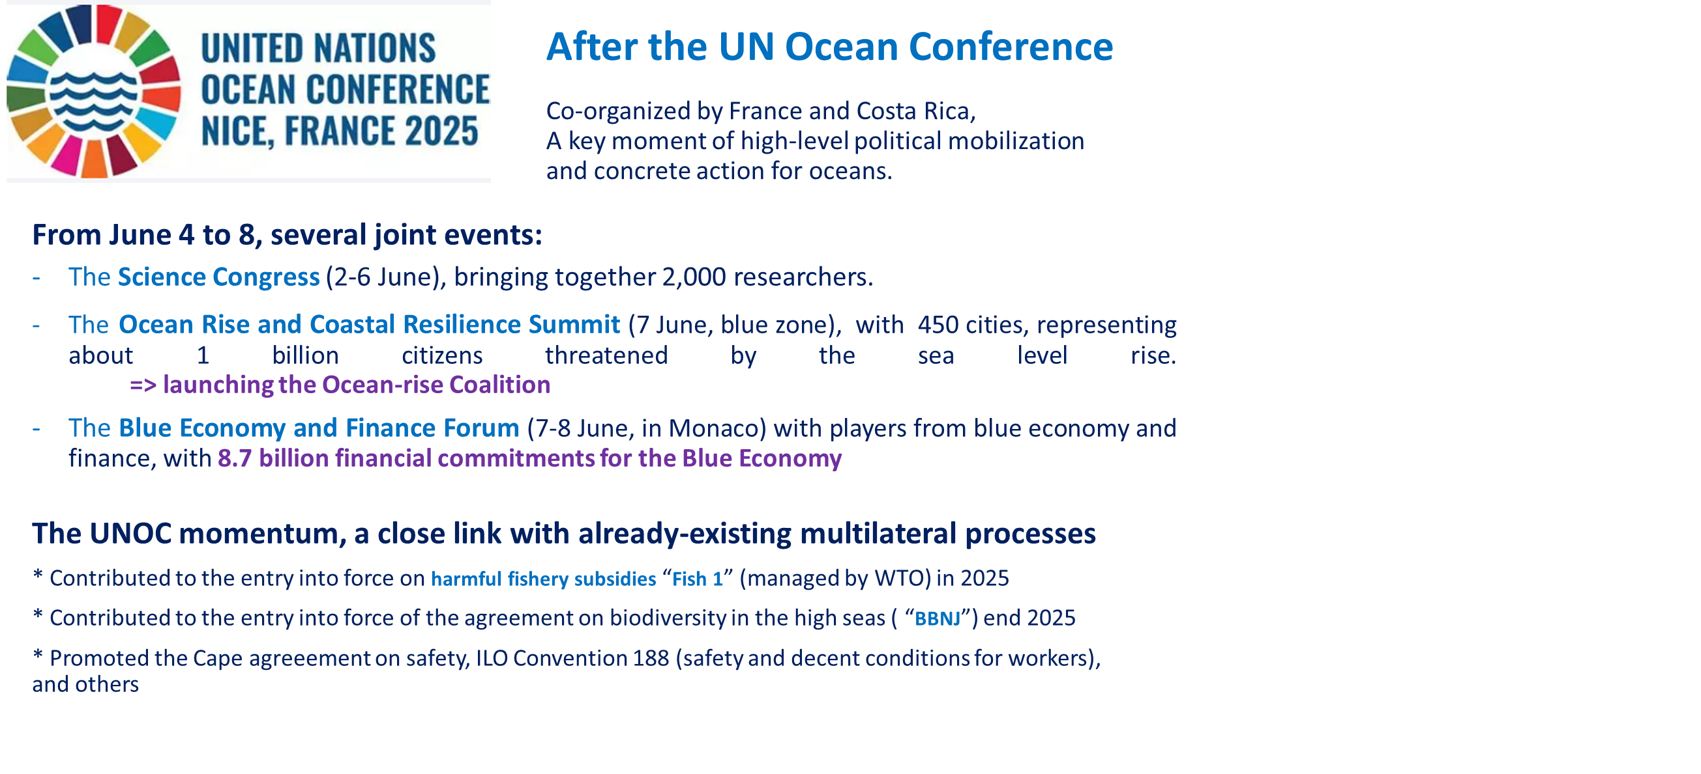

Slide 5
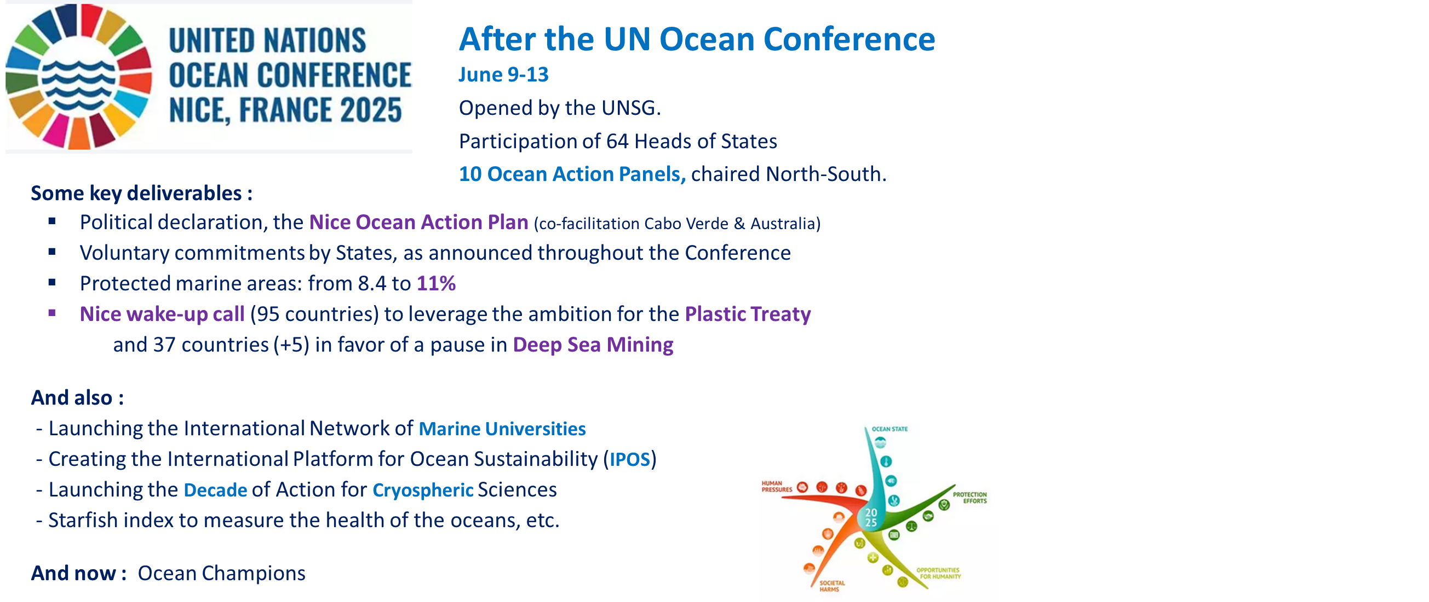

Slide 6
ANTONELLA VASSALLO
International Ocean Institute (IOI), Managing Director

Slide 7
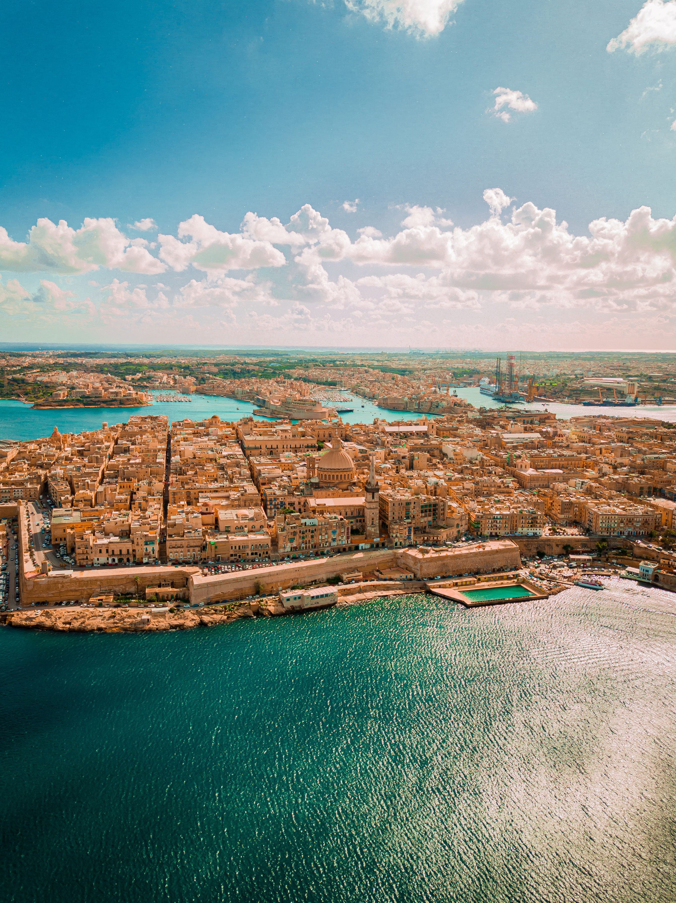

Understanding the
Ocean – Climate–Human Nexus
  The ocean regulates our climate, sustains livelihoods,
and connects every community.
  Coastal cities sit at the frontline: both as
contributors to and victims of plastic pollution.
  Building awareness of this interconnectedness
is essential for shifting from reactive to responsible governance.

Slide 8
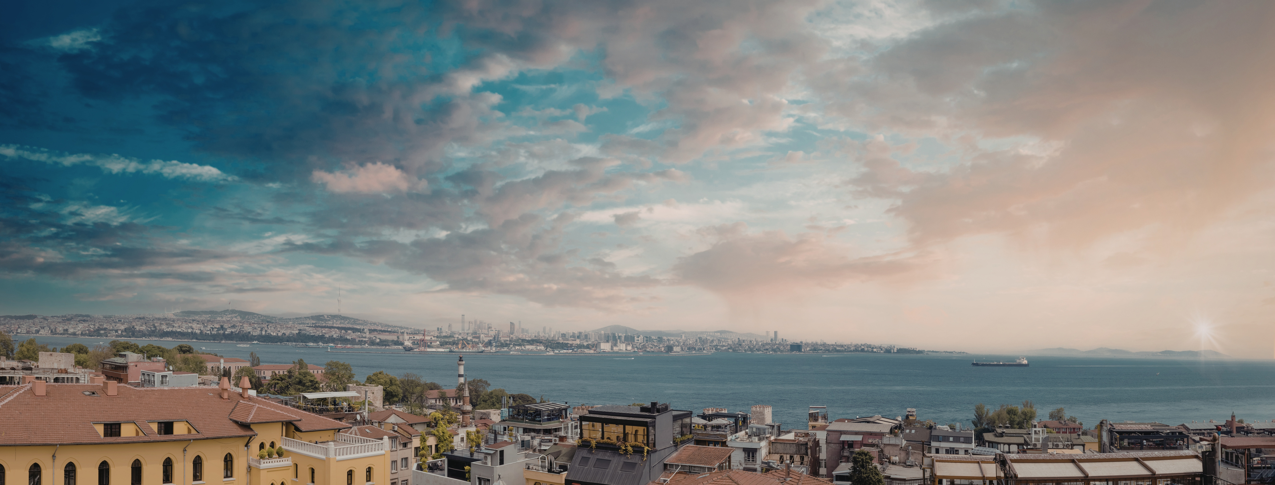
Empowering Action
through Understanding
  Ocean literacy means understanding the ocean’s influence on us - and our influence on the ocean.
  Beyond knowledge: it’s a foundation for behavioural change, policy coherence, and collective stewardship.
  IOI integrates ocean and climate literacy into its capacity development - connecting science, governance, and leadership training.

Slide 9
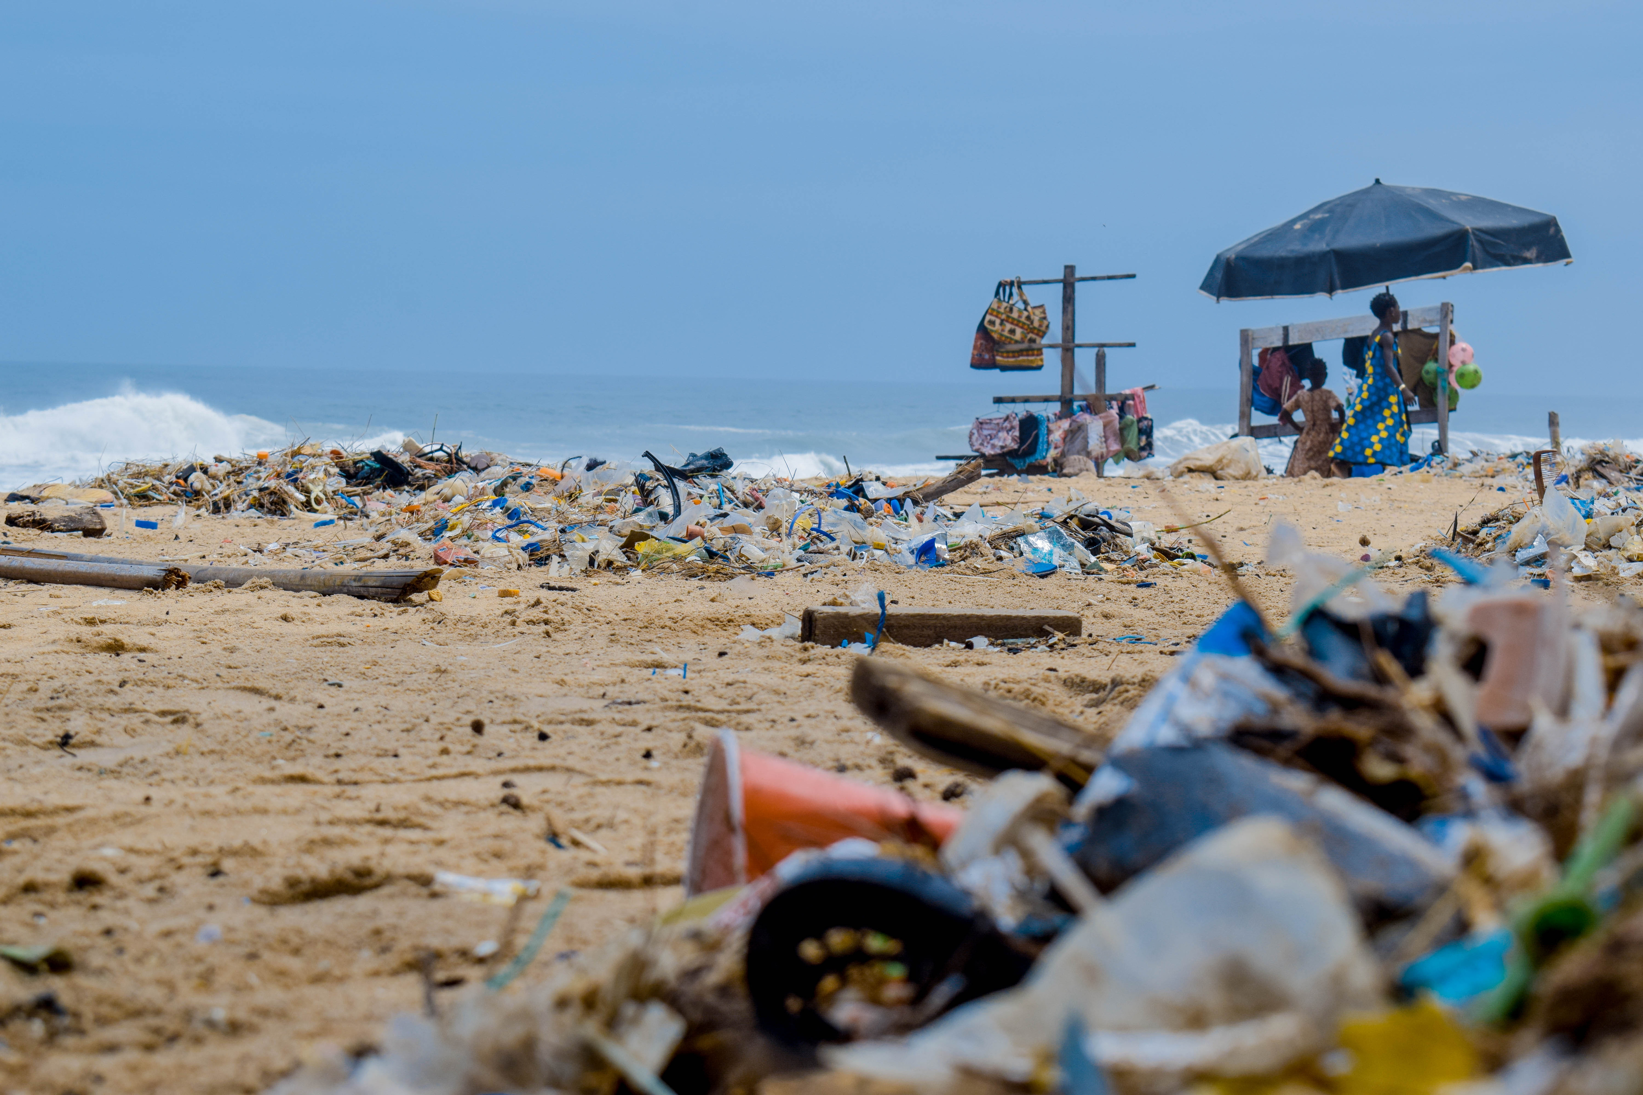
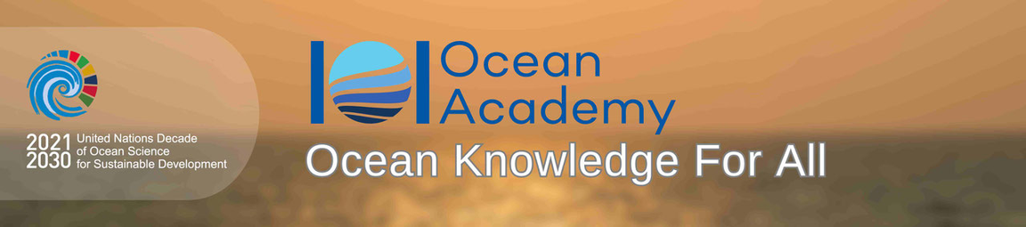
Turning Knowledge into Action
  IOI’s training and leadership programmes build the skills, understanding, and networks needed for effective ocean governance.
  Informed decision-making enables cities and nations to design policies that are sustainable, inclusive, and evidence-based.
  Strengthening capacity bridges the gap between knowledge and policy - empowering leaders to act on the plastic challenge.

Slide 10
GRAHAM ALABASTER
Head of UN Habitat Geneva Office

Slide 11
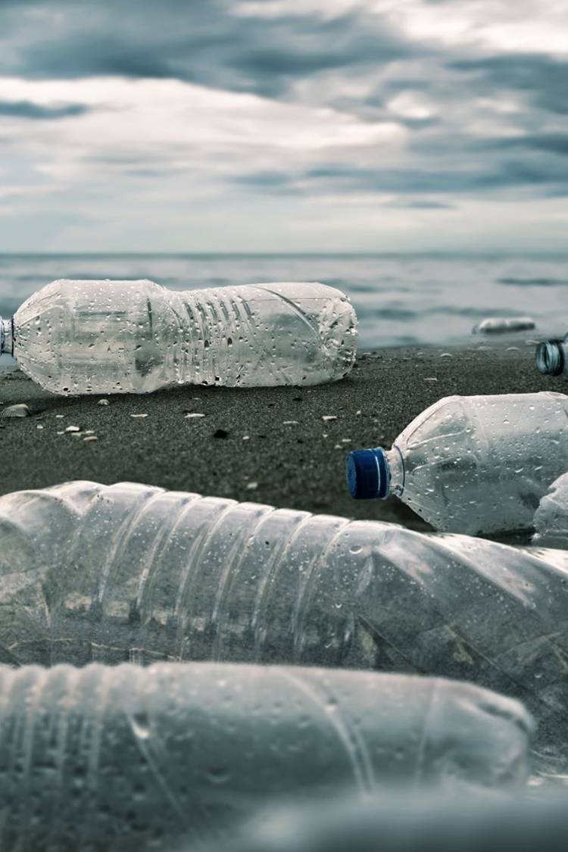



Coastal Cities:
From Sources of Plastic
to Circular Economy Leaders
Side-event “Coastal Cities as Source and Solution:
Shifting the Plastics Pollution Paradigm”
4 November 2025
World Meteorological Organization
Dr Graham Alabaster
Chief, Geneva Office
Office of the Executive Director
graham.alabaster@un.org

Slide 12


Why do coastal
cities matter ?
Coastal cities concentrate plastic leakage due to high population density, inadequate municipal solid waste (MSW) systems, and river/stormwater drainage systems.
UN‑Habitat frames action around: improved MSW, data-driven planning, and inclusion of informal waste workers.
Key UN‑Habitat initiatives: Waste Wise Cities, Blue Economy guidance and city partnerships to reduce plastic leakage.

Slide 13

Priority pathways
for coastal city transition
  Strengthen municipal collection, safe transfer stations and coastal litter traps to stop leakage.
  Scale circular business models: reuse/refill systems, material recovery, local recycling with social inclusion.
  Push policy levers: local EPR implementation, deposit-return, procurement for circular materials.
  Use city data & targets (waste flow mapping, monitoring) to design interventions and measure progress.
  Mobilize finance & partnerships (public‑private, international funds) and formalize informal workers.
Recommendations
& Actionable Steps

Slide 14

GABRIEL BOICHAT
Head of the Delegation of the Government of Catalonia to Switzerland

Slide 15
DATO’IR RAJENDRAN P. ANTHONY
Mayor, Penang Island, Malaysia

Slide 16
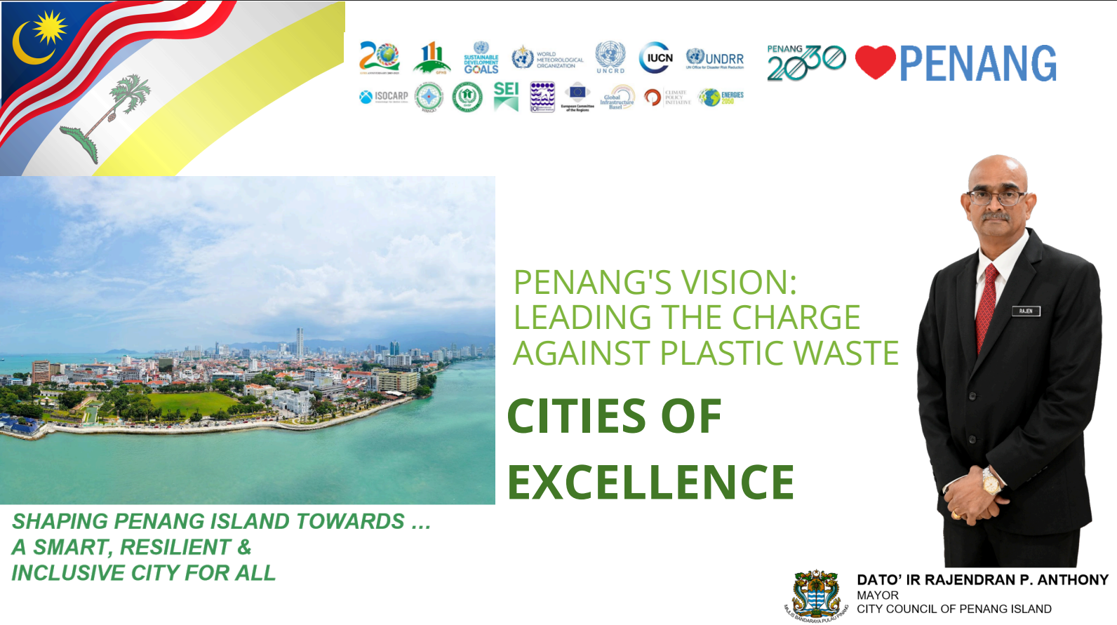

Slide 17
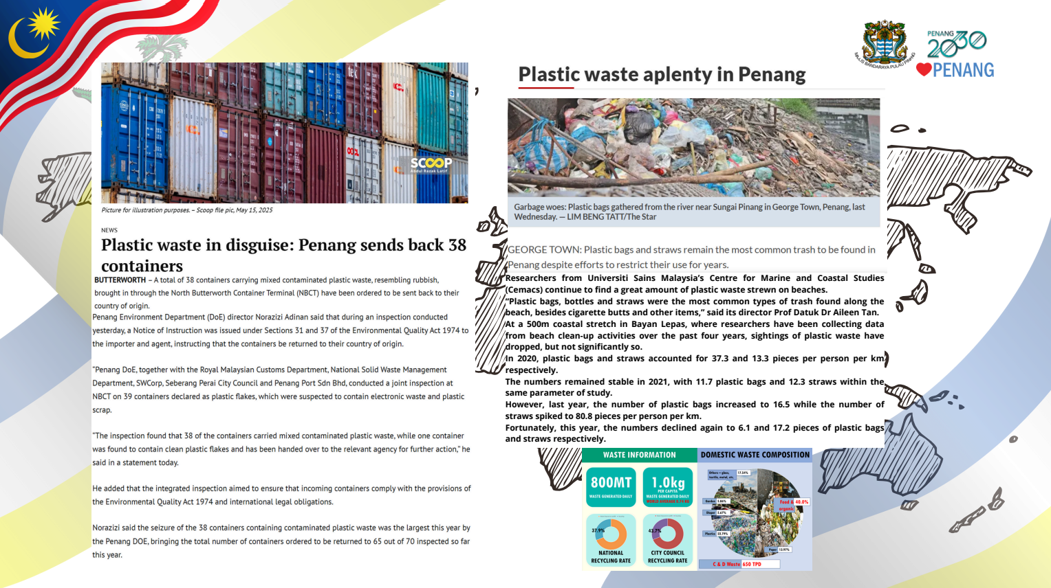

Slide 18
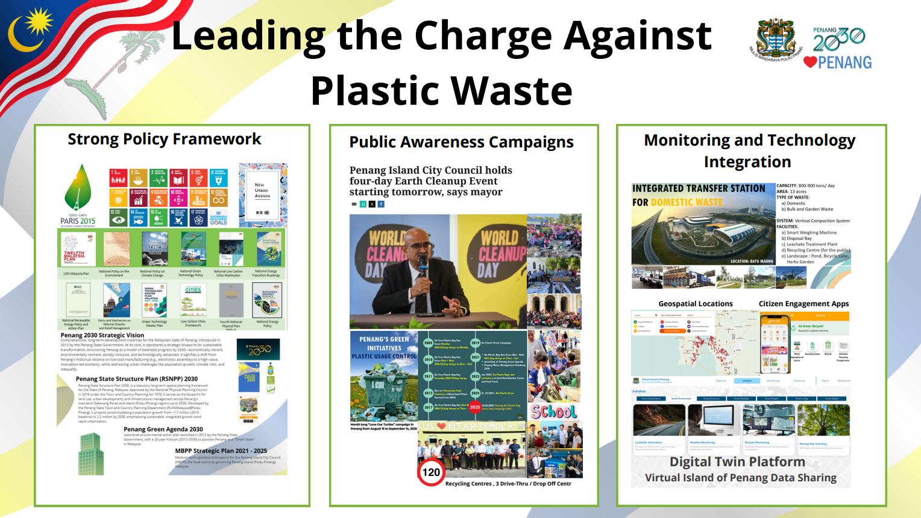

Slide 19
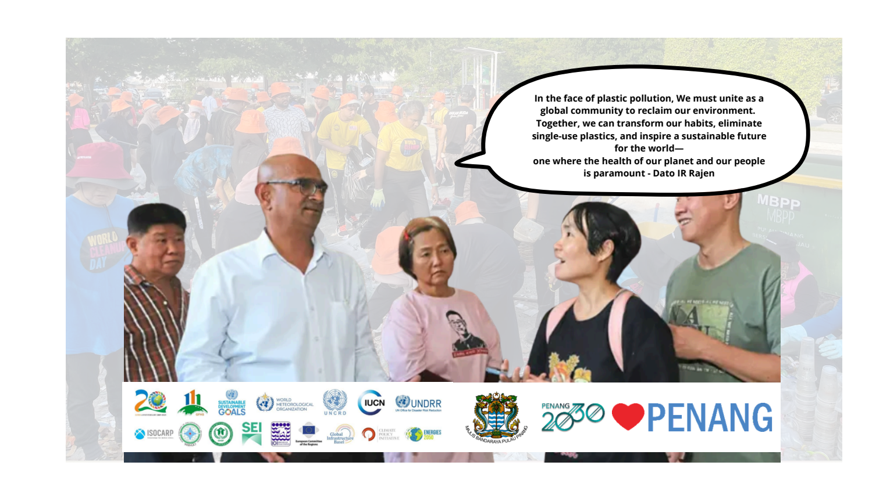

Slide 20
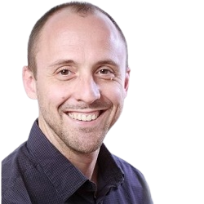
MODERATOR
SPEAKERS
ANDRÀS
SZORÉNYI
RÉGIS
FARRET
ANTONELLA
VASSALLO
GRAHAM
ALABASTER
GABRIEL
BOICHAT
DATO’IR RAJENDRAN P. ANTHONY
Senior Policy Advisor,
Global Cities Hub
Counsellor for Sustainable Development, Permanent Mission
of France to the United Nations
International Ocean Institute (IOI), Managing Director
Head of UN Habitat
Geneva Office
Head of Delegation
of Catalonia in Geneva
Mayor of City Council,
Penang Island, Malaysia
COASTAL CITIES AS SOURCE AND SOLUTION:
SHIFTING THE PLASTICS POLLUTION PARADIGM

